Slide 1




Expense Tracker & Analyzer
Ekta Awasthi
Tashi Garg
Dongyang Su
Ikedinachim Ugochukwu

Slide 2

Overview
The Expense Tracker & Analyzer will allow you to have:
Secure User Authentication
User registration and login system
User profile management
Comprehensive Personal Finance Management
Expense Management Features
Add, view, and categorize expenses
Visualize monthly expense summaries with intuitive charts and graphs
Predict future expenses
Income Tracking
Record and categorize income sources
Visualize monthly income breakdown with intuitive charts and graphs
Personalized savings recommendations
Data Storage

Slide 3

Required Technologies/Tools
Backend
FastAPI (high-performance REST API framework)
Frontend
Jinja2 Templates, Bootstrap, JQuery
Data Management
MongoDB (scalable NoSQL database)
Machine Learning Models
Tensorflow & Keras (LSTM models) for expenses prediction,
Scikit-learn (MinMaxScaler) for data normalization, and (NearestNeighbors) for savings recommendation.

Slide 4
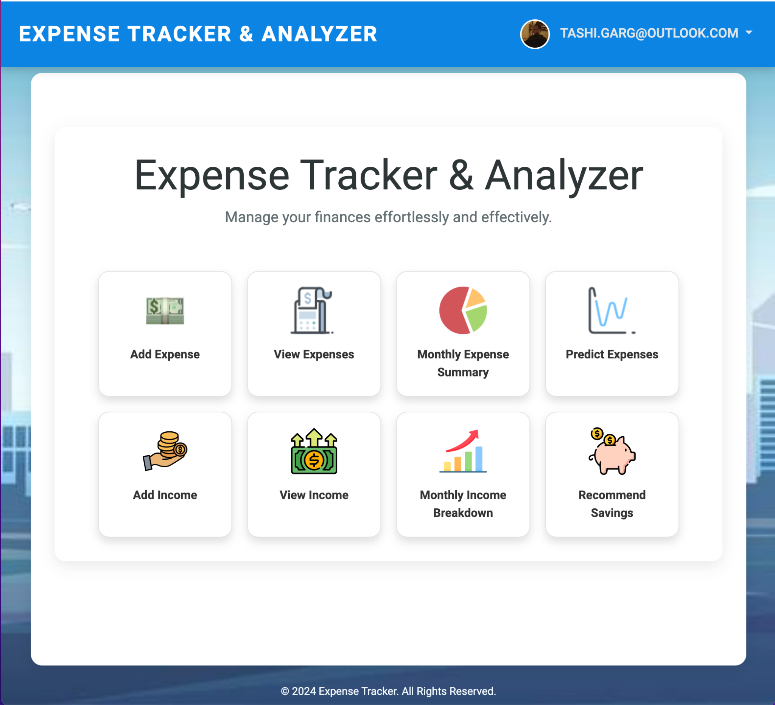

Project Demo

Slide 5
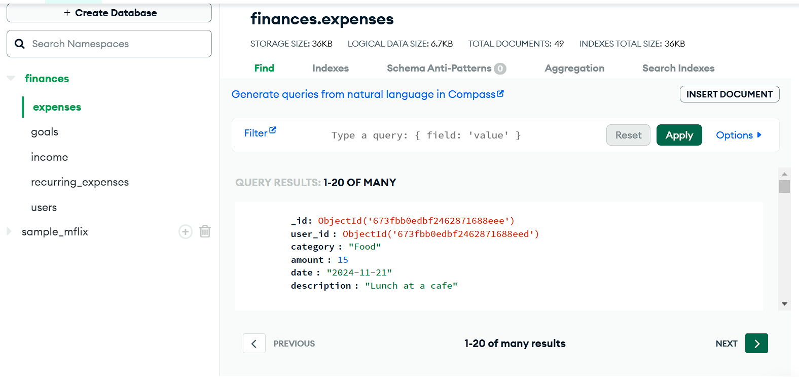
Data Storage
MongoDB is a document-oriented database program that's used to store and manage large amounts of data. It's a NoSQL database, which means it uses a document-based model instead of tables. MongoDB is known for its flexibility, scalability, and high performance. For this Project we made use of MongoDB to store users expenses, incomes, login information. MongoDB makes it easy for us to perform validation and CRUD operations on our data.

Slide 6
Key Technology/Tools Differences
SQLite /MongoDB
Add a few pointers

Slide 7

GUI Tech Stack
Jinja2 Templates (for Dynamic HTML)
Bootstrap (for Styling)
JQuery (for Scripting)
Chart.js (for charts)
DataTable.js (to support Pagination, Filtering and Searching on tables)

Slide 8

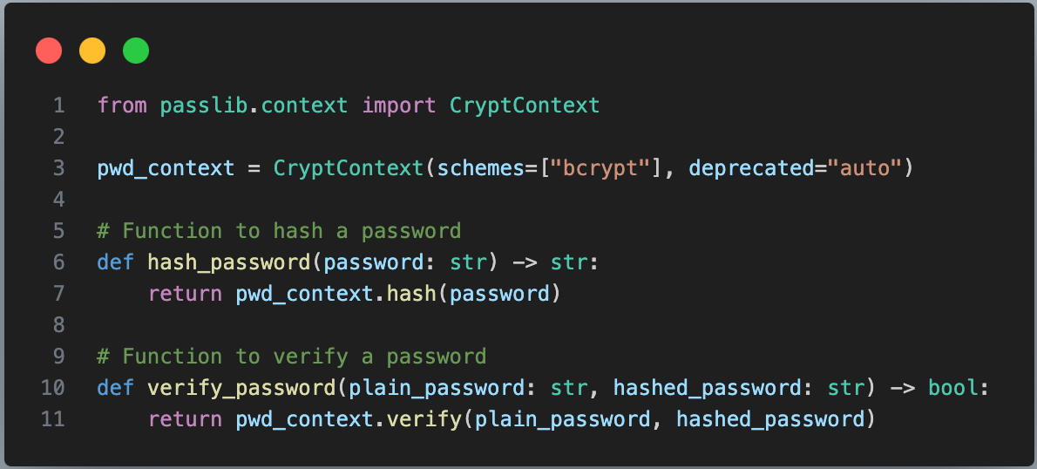
Secure User Authentication
User registration and login system powered by bcrypt for password security.

Slide 9
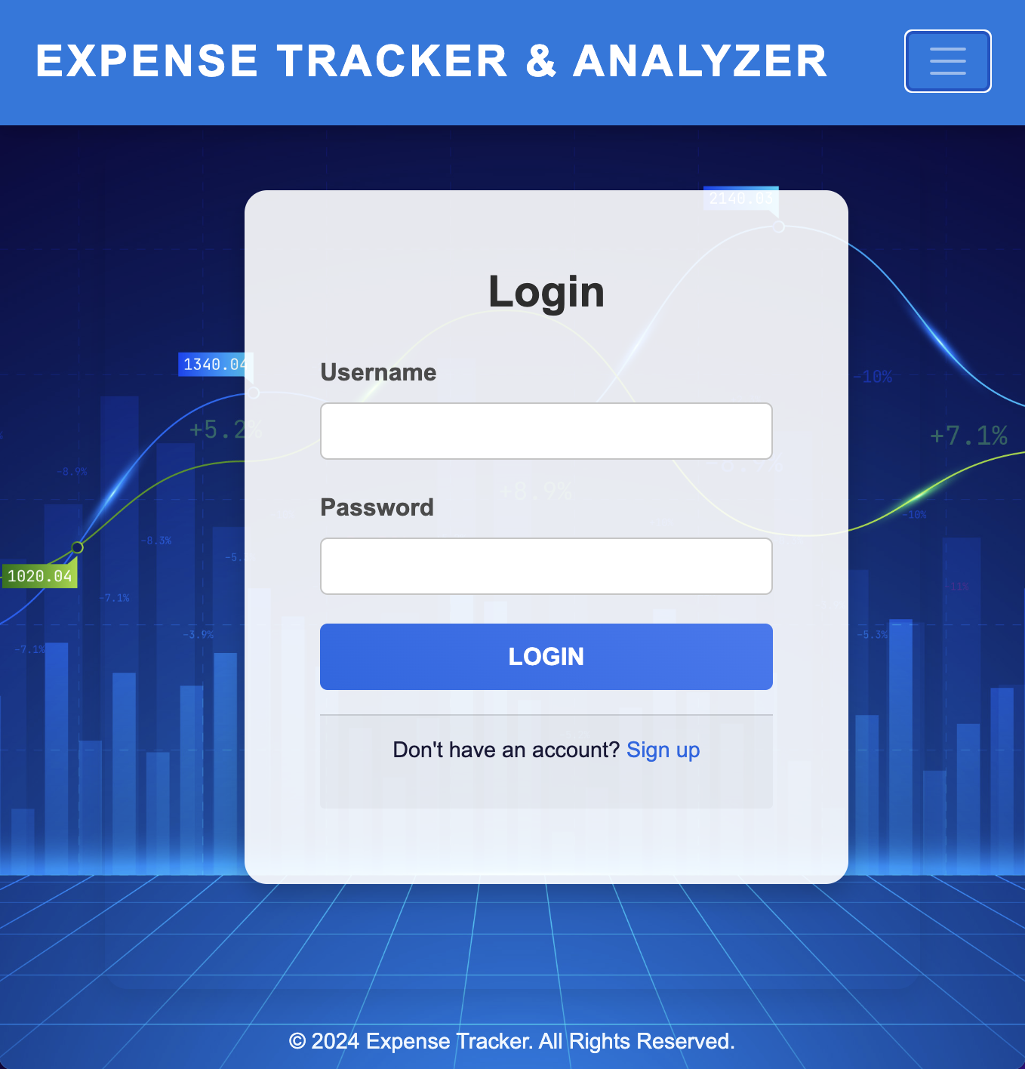
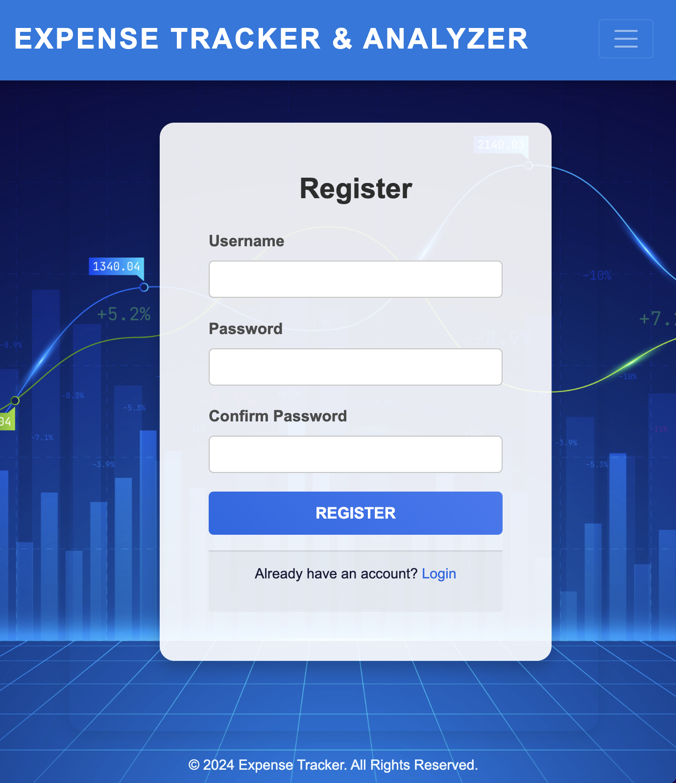

Secure User Authentication
User profile management
Register/Sign up
Login/Logout
Update profile
username
email
password

Slide 10

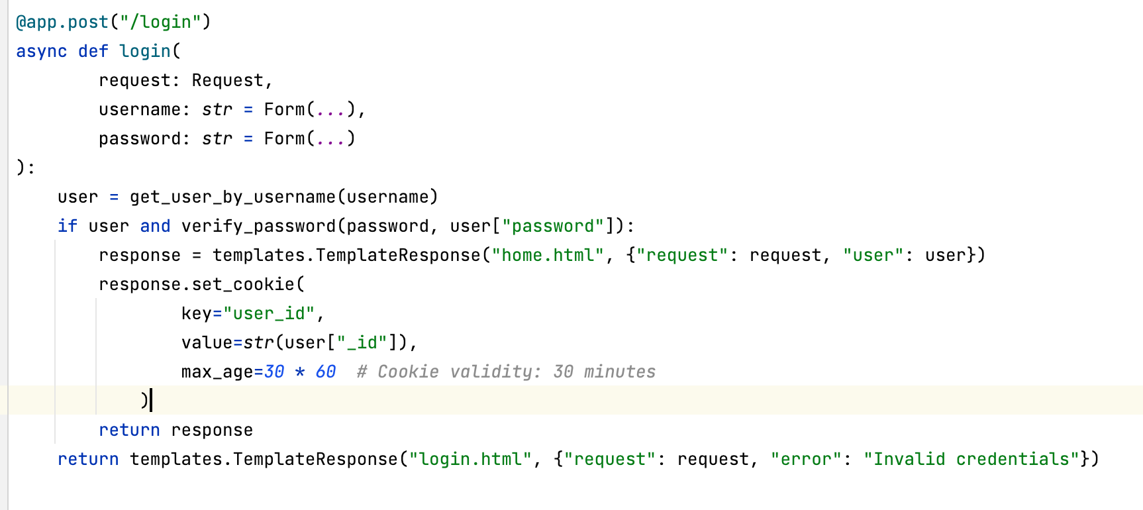
Session Management
Maintaining the session in the browser using cookies

Slide 11
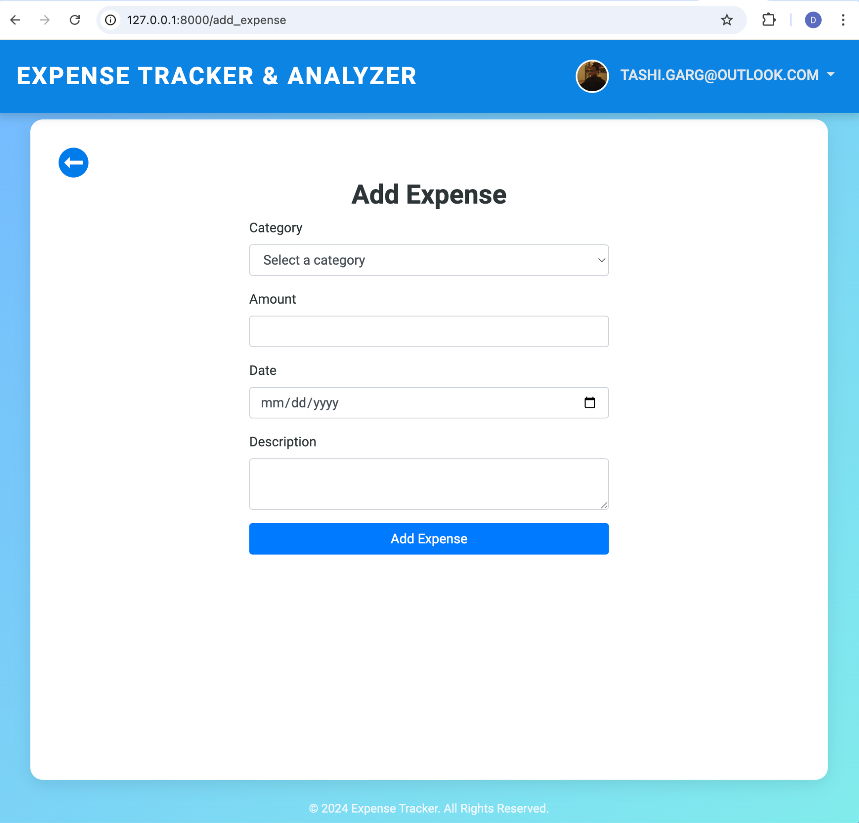

Expense Management Features
Forms

Slide 12
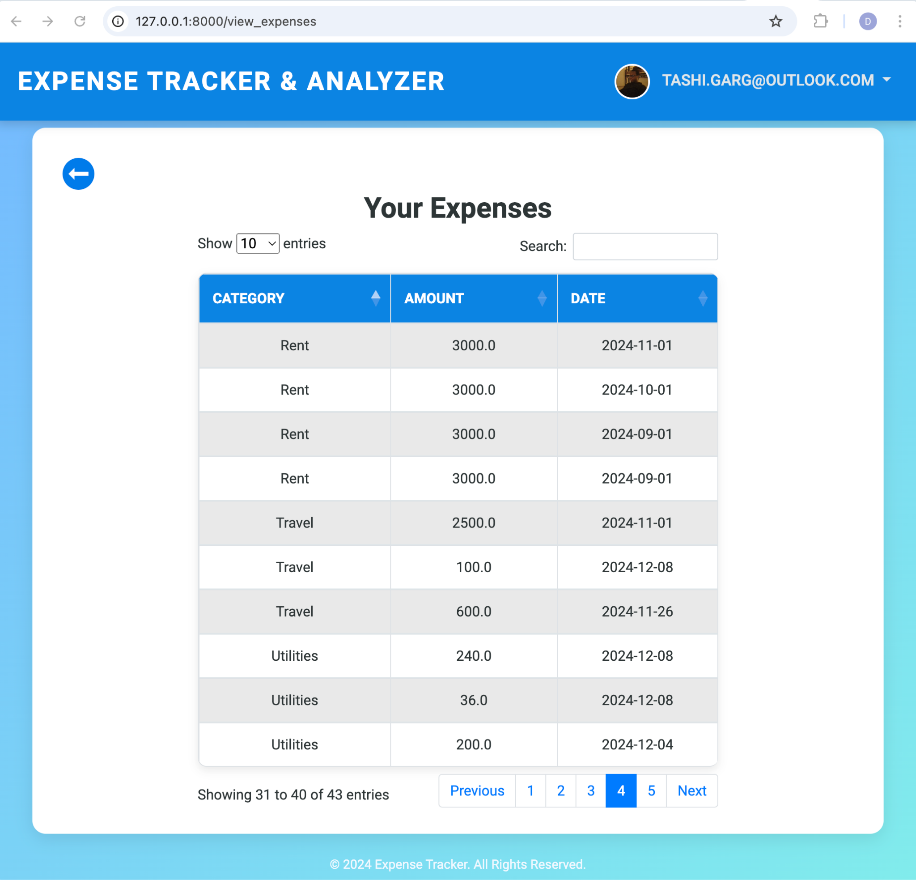

Expense Management Features
Interactive Tables supporting - Sorting, Filtering, Pagination

Slide 13

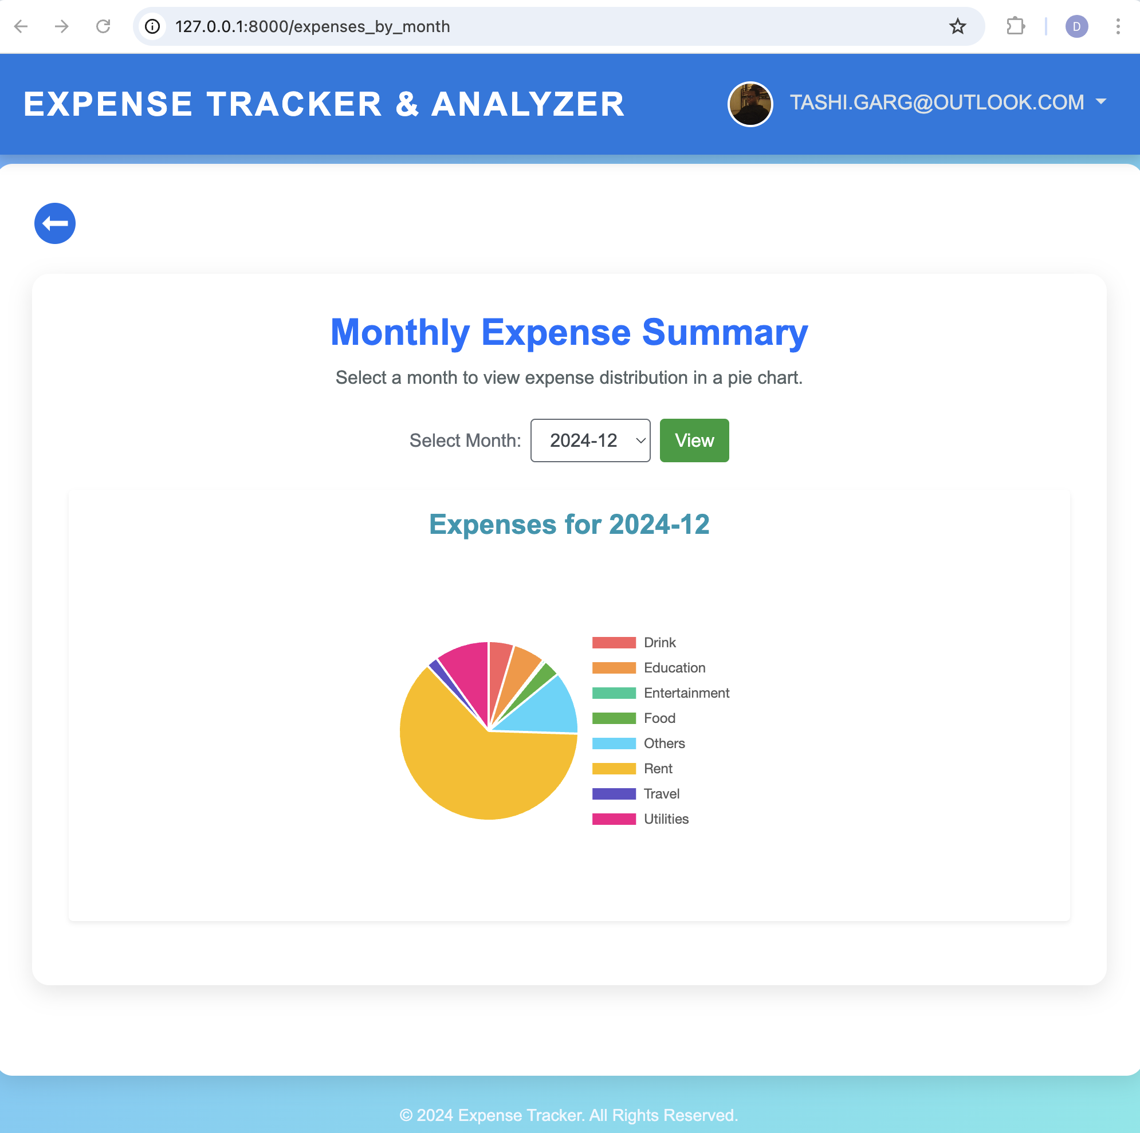
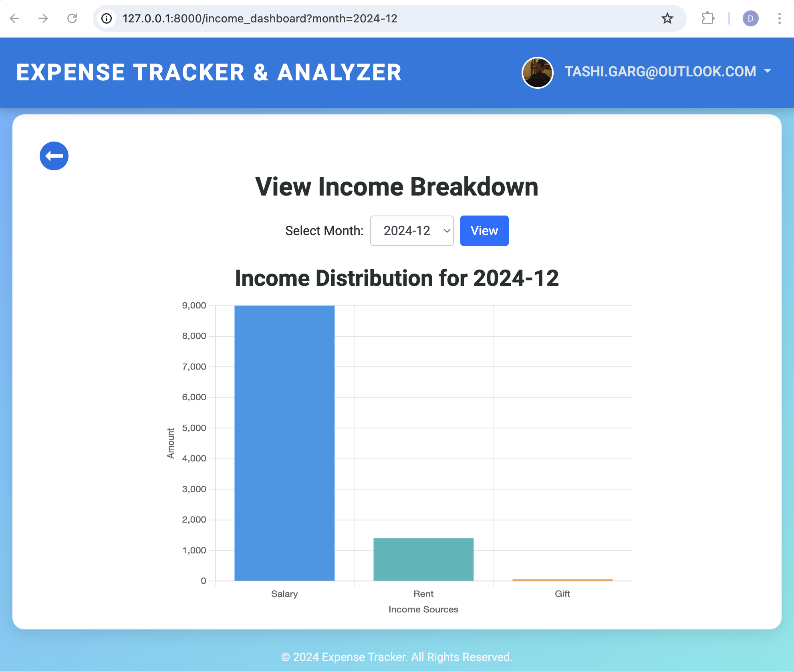
Expense Management Features
Intuitive charts and graphs

Slide 14
FastAPIs
User Authentication -
GET /login and POST /login
GET /profile and POST /profile
Expense Management -
GET /add_expense and POST /add_expense
GET /view_expenses
Income Management-
GET /add_income and POST /add_income
GET /view_income
Predictive Features-
GET /predict_expenses
GET /recommend_savings
Visualizations & Dashboards-
GET /expenses_by_month
GET /income_dashboard
Notes:
We chose FastAPI for our app because it’s incredibly efficient and perfect for building REST APIs that interact with our database and frontend. Why FastAPI?
Fast: Built with async capabilities, making it highly efficient even under high load.
Easy to use: With automatic documentation and interactive API docs (Swagger UI).
Highly customizable: Ideal for integrating machine learning models and database operations.
User Authentication
GET /login and POST /login: Handles user login and session management through cookies.
GET /profile: Fetches and displays the user profile information.
POST /profile: Allows users to update their profile details.
Expense Management
GET /add_expense: Displays the page for adding a new expense.
POST /add_expense: Accepts data from the user and stores it in the database.
GET /view_expenses: Displays all the user’s expenses, with an option to view them by category and date.
Income Management
GET /add_income: Displays the page for adding income.
POST /add_income: Accepts income data from the user and stores it.
GET /view_income: Displays the user’s income, categorized by source and date.
Predictive Features
GET /predict_expenses: Uses machine learning (LSTM models) to predict future expenses based on historical data.
GET /recommend_savings: Offers personalized savings recommendations based on spending patterns.
Visualizations & Dashboards
GET /expenses_by_month: Visualizes monthly expense data and categorizes it for better financial planning.
GET /income_dashboard: Displays income data over different months, helping users track their financial inflow.

Slide 15

Expense Management Features
Predict future expenses - http://127.0.0.1:8000/predict_expenses
Intro to Long Short-Term Memory (LSTM) Model
LSTM - advanced Recurrent Neural Networks designed to recognize patterns in sequences of data, ideal for predicting financial time series.
The goal is to predict monthly expenses based on historical data/spending patterns.
Notes:
Long Short-Term Memory (LSTM) networks are a special kind of Recurrent Neural Network (RNN) capable of learning long-term dependencies.
They are particularly effective in forecasting scenarios where context from the input data extends over long periods, making them ideal for time-series analysis like monthly expense tracking.

Slide 16
Expense Management Features
Predict future expenses - http://127.0.0.1:8000/predict_expenses
Data Preparation & Normalization
Fetch & Validate data - The data is sourced using a function fetch_expense_data, which pulls transaction records from a database for a specified user ID. It's crucial to ensure that the data is neither empty nor minimal (at least two records are needed to proceed).
Set Index and Resampling - The 'date' column of the dataset is set as the index to facilitate time-series operations. The data is then resampled to compile expenses at the month-end frequency, aggregating total expenditures per month.
Normalization - We apply MinMaxScaler to scale the numerical values of expenses to a range of 0 to 1. This transformation is critical for optimizing the LSTM model’s performance, as it ensures that the model trains on data that's within a standardized range, reducing the likelihood of distortions due to outliers.
Notes:
Long Short-Term Memory (LSTM) networks are a special kind of Recurrent Neural Network (RNN) capable of learning long-term dependencies.
They are particularly effective in forecasting scenarios where context from the input data extends over long periods, making them ideal for time-series analysis like monthly expense tracking.

Slide 17
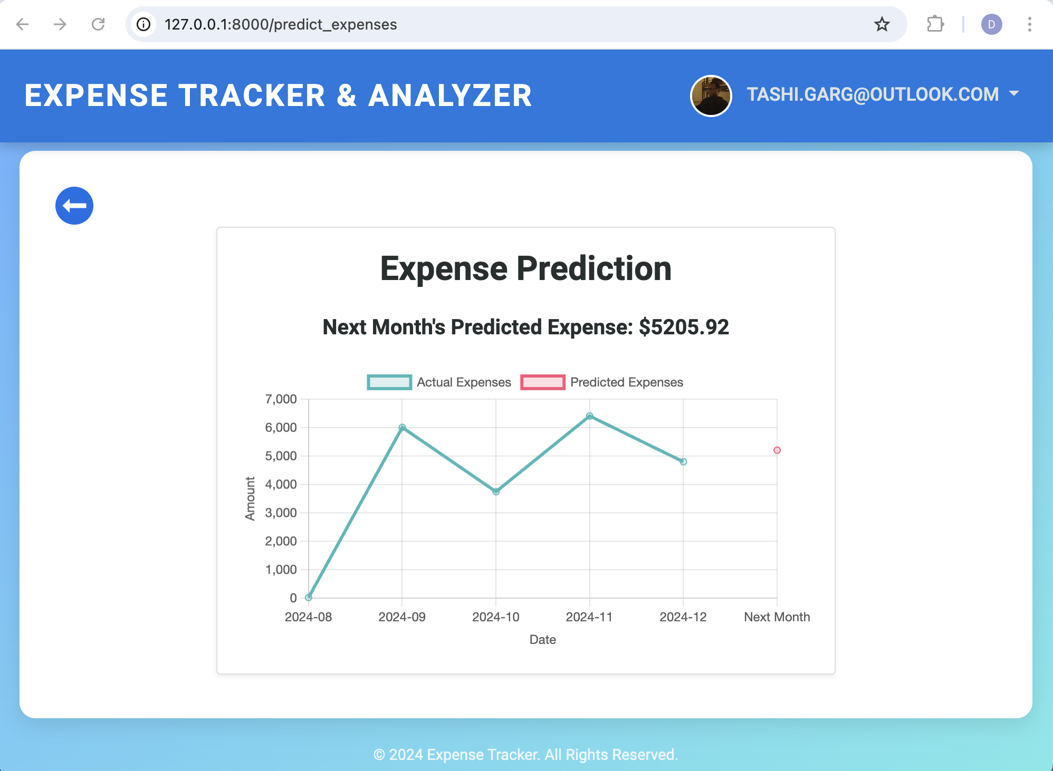

Expense Management Features
Predict future expenses - http://127.0.0.1:8000/predict_expenses

Slide 18
Expense Management Features
Predict future expenses - http://127.0.0.1:8000/predict_expenses
Train the LSTM Model
The model is compiled with the mean squared error loss function and the Adam optimizer. It is then trained silently (without outputting progress logs) for 20 epochs with a batch size of 1, optimizing the model to predict the next month's expenses accurately.
Model Deployment
Post-training, the model along with the scaler is utilized to predict next month’s expenses based on the most recent data inputs.
Prediction Process:
The last recorded expense amount is normalized, fed into the model to forecast the upcoming month’s expenses, and then inversely scaled back to provide a prediction in actual currency values.
This predictive output assists in proactive budget adjustments and financial planning.
Notes:
Long Short-Term Memory (LSTM) networks are a special kind of Recurrent Neural Network (RNN) capable of learning long-term dependencies.
They are particularly effective in forecasting scenarios where context from the input data extends over long periods, making them ideal for time-series analysis like monthly expense tracking.

Slide 19
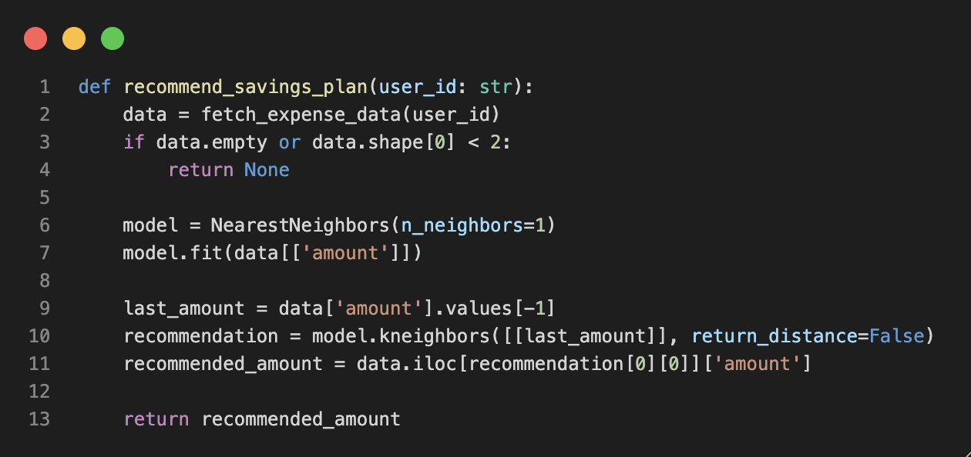
Personalized Savings Recommendations
Recommended Savings Plan - http://127.0.0.1:8000/recommend_savings
Objective
To recommend a feasible savings target based on a user's past expense data.
Process Flow
Data Retrieval
Fetches expense data for the specified user and checks for adequacy.
Model Implementation
Utilizes the Nearest Neighbors algorithm with n_neighbors=1 to identify the expense amount closest to the user’s last recorded amount.
Recommendation Logic
Identifies the last transaction amount from the user's expense data.
Finds the closest amount in the historical data, suggesting this as the target for savings.

Slide 20
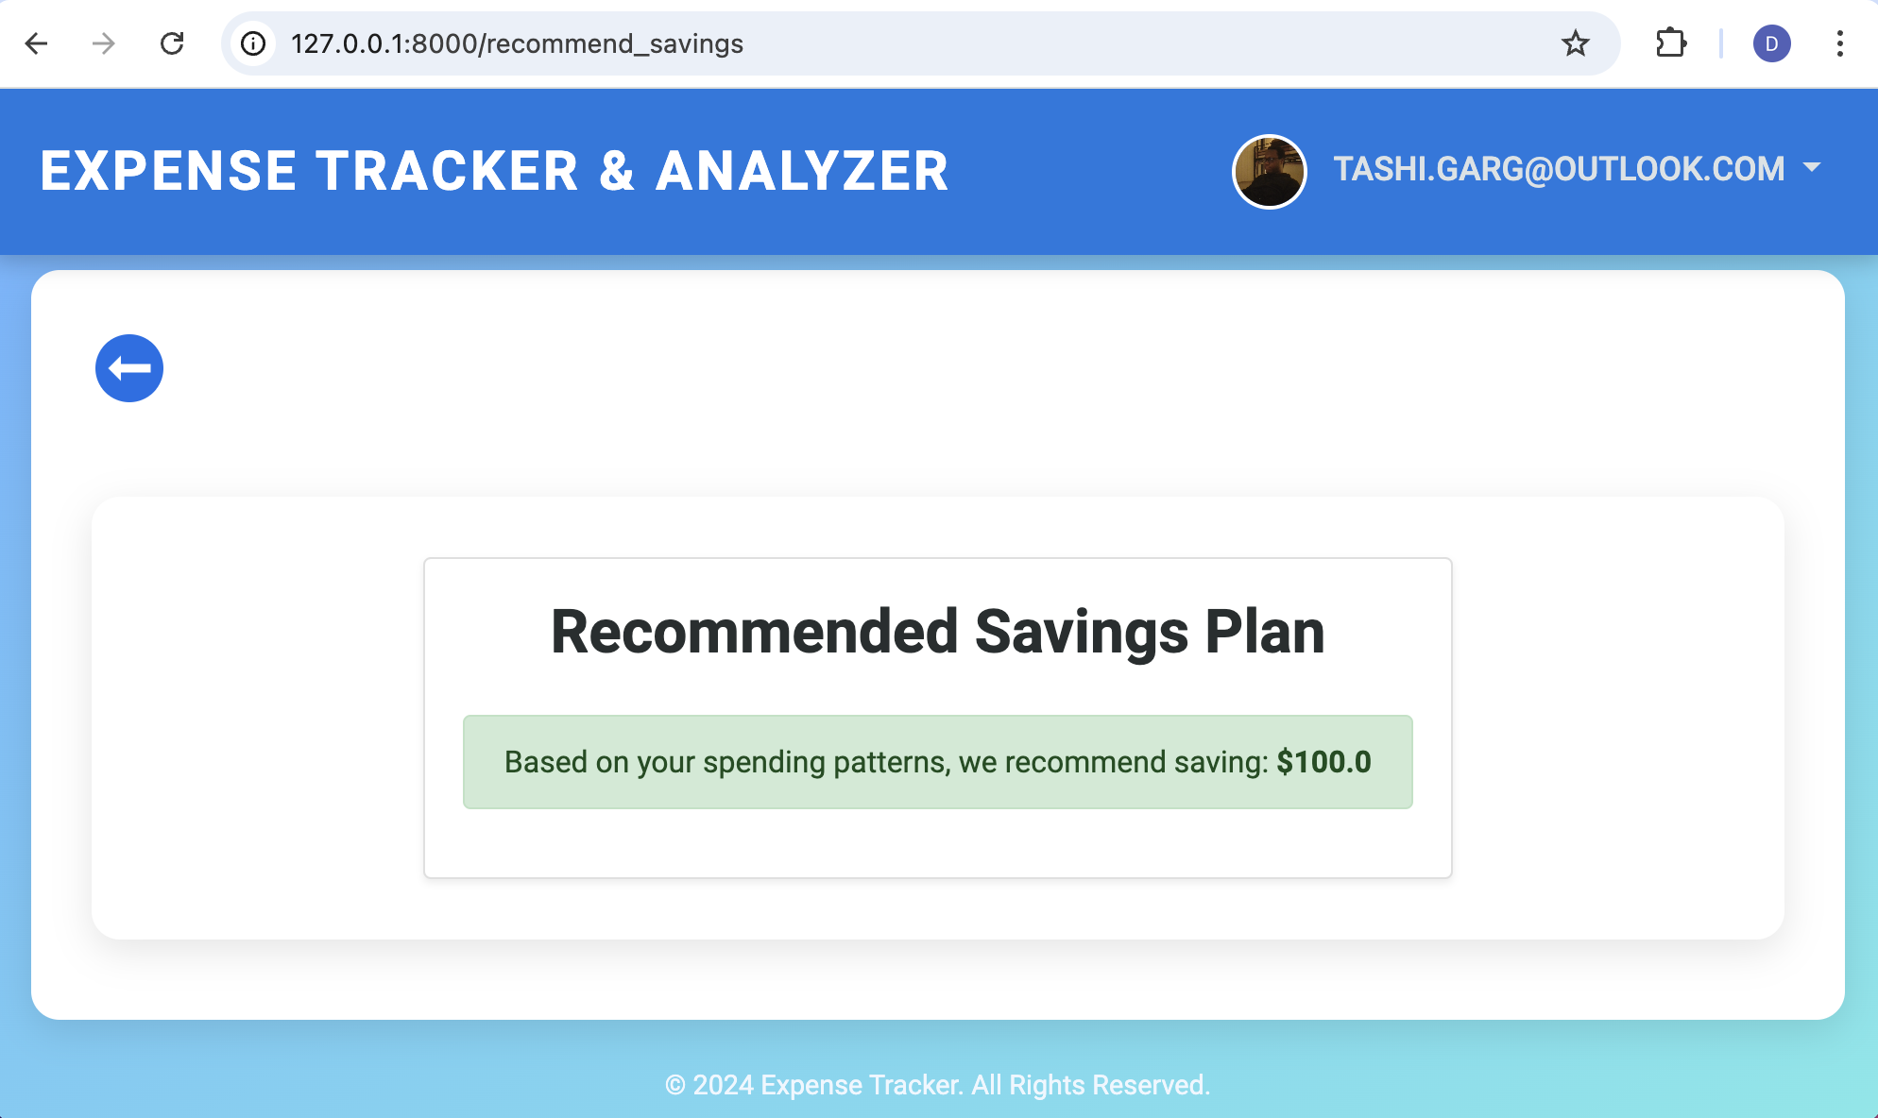
Personalized Savings Recommendations
Pros & Cons and Potential Improvements
Pros
Simplicity and Speed
Data-Driven Recommendations
Personalization
Cons
Potential for Outliers
Potential Improvements
Utilize Averages or Trends
Integrate User Input
Dynamic Updates
Notes:
Pros
Simplicity and Speed
Quick and straightforward approach using the last transaction to recommend savings.
Data-Driven Recommendations
Utilizes actual transaction data to tailor savings advice, potentially making it more relevant than generic suggestions.
Personalization
Each user's recommendation is based on their own spending patterns, offering a customized approach.
Cons
Potential for Outliers
A single, atypical expense can skew the savings recommendation.
Relies on the nearest historical data point, which may not always be indicative of future financial capacity.
Potential Improvements
Utilize Averages or Trends
Employ averages or financial trend analysis to stabilize recommendations against outliers.
Enhance with Machine Learning:
Implement more complex algorithms to learn from broader financial behaviors and adapt over time.
Integrate User Input
Allow user customization of parameters to align recommendations more closely with personal financial goals.
Dynamic Updates
Periodically adjust the model based on new spending data to keep the savings targets relevant.

Slide 21

References
Personal Finance App By Ali Mahmudi

Slide 22

Thank You!
Happy Holidays!

